Slide 1
Methods 2 Classroom 5

Slide 2
TODAY
Linear algebra basics: vectors, matrices, norms, transposition
Recap notation and some properties
I can guide still the first exercises
Feel free to not follow along – and ask Chris for help if I am unavailable
Remember to keep asking if you are stuck ☺
The exercises are found here in the slides (almost all are doable by hand)

Slide 3
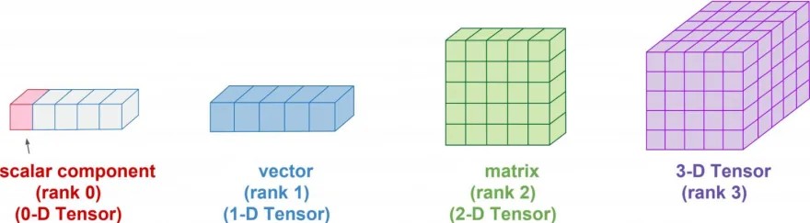
Scalar, Vector, Matrix, Tensor, Array
- In programming lingo multidimensional structures are also known as arrays

Slide 4
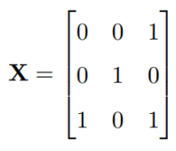
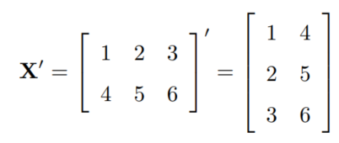
Notation in Gill, 2006
Vectors and matrices are denoted in bold
Lower cases on vectors
Upper cases on matrices
‘ means transposed

Slide 5
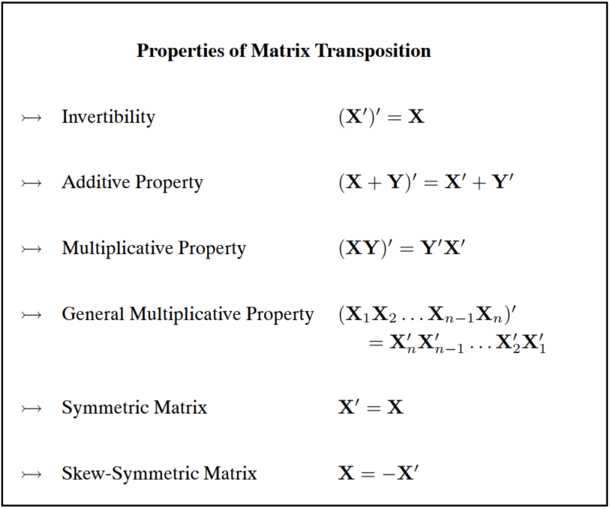
Properties of transposition

Slide 6
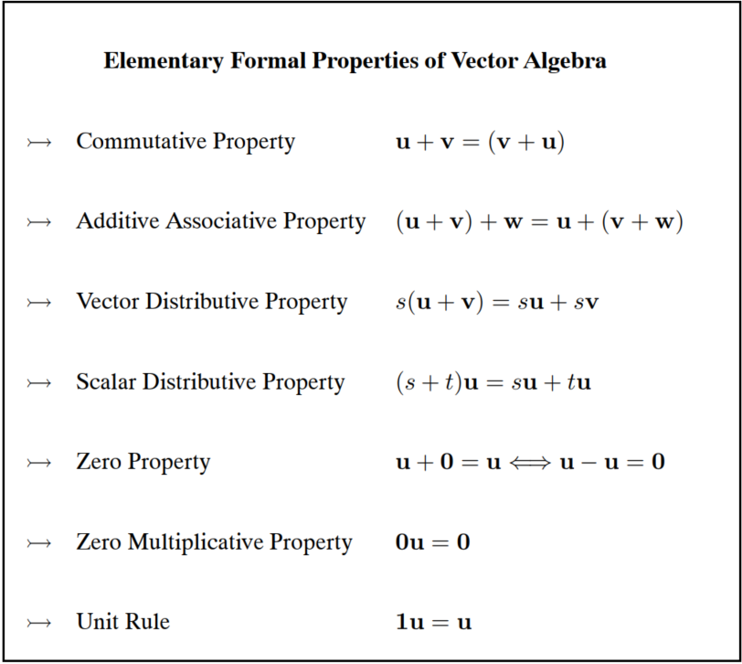
Elementary Vector Albegra

Slide 7


Vector/Matrix products
Cross product (only for vector)
Dot product (for both vectors and matrices)
Hadamard / elementwise (for both vectors and matrices)

Slide 8

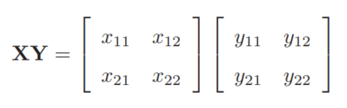
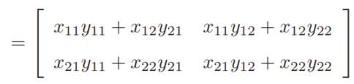

Dot Product / Inner product
Example with 2-by-2 matrices
NB! This has to be true ☺

Slide 9
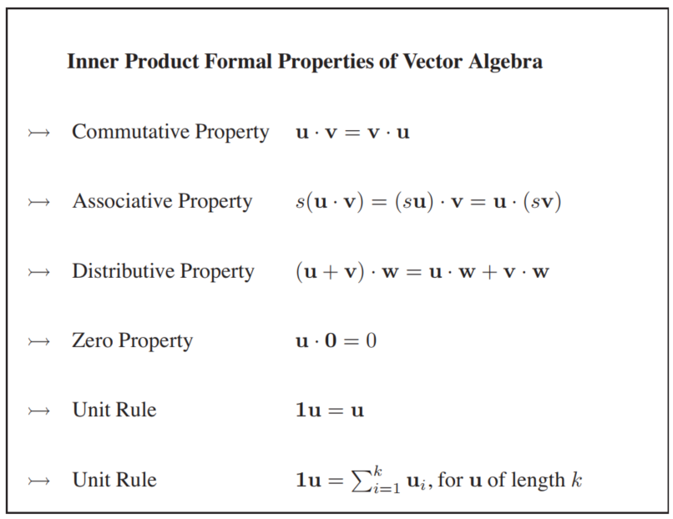
Inner Product Properties

Slide 10
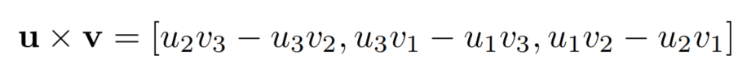
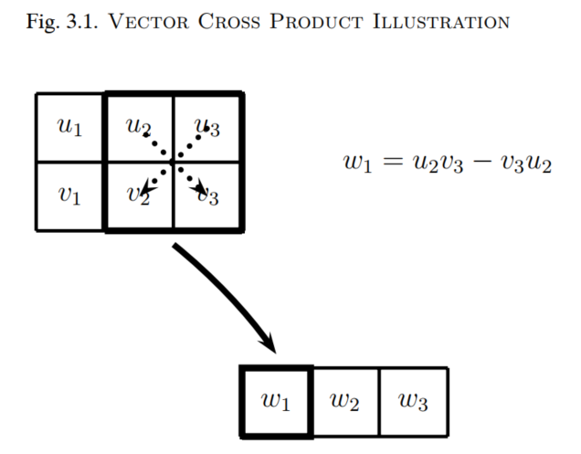
Cross product / Outer product
Might help to view it as 3 determinants (which you might have learned in high school)

Slide 11
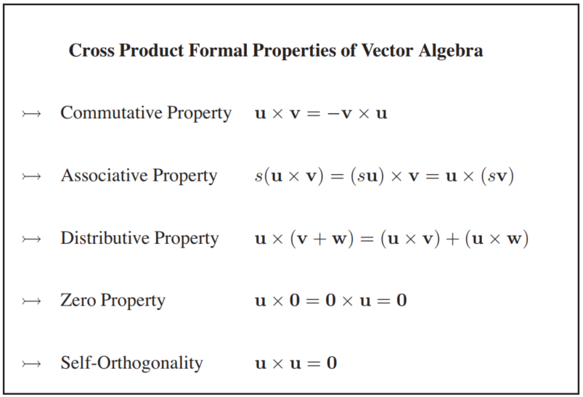
Cross product properties

Slide 12
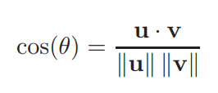
Exercises
3.1
3.10
3.7
3.11
Come up with examples of the following matrices and explain why they are called so:
Square matrix
Symmetric matrix
Diagonal matrix
Identity matrix
J Matrix and 0 matrix
3.13 (challenging)
3.22
3.23 (optional, extra challenging)
Hint for 3.23
Utilize that

